Slide 1

FACULTY OF ENGINEERING AND TECHNOLOGY
ELECTRICAL AND COMPUTER ENGINEERING DEPARTMENT
ADVANCED COMPUTER ARCHITECTURE
ENCS5331
PROJECT PRESENTATION :
NM-RAG: A NEAR-MEMORY COMPUTING ACCELERATOR FOR RETRIEVAL-AUGMENTED GENERATION SYSTEMS
Name: Kareem Hamza ID: 1220708
Name: Noor Battat ID: 1210075
Name: Anas Sarabtta ID: 1200242
DR. AYMAN HROUB

Slide 2

Outline
Introduction
Problem & Motivation
Contributions
Related Work & Gap
Proposed Solution (Architecture + Quantization + Pipeline)
Experimental Results
Conclusion

Slide 3
Introduction
What is RAG? It retrieves relevant passages from a vector database, then the LLM generates an answer using that context.
Why it matters: user experience depends on TTFT, which includes retrieval latency + prefill.
This work’s focus: accelerate the retrieval stage (the memory bottleneck).

Slide 4
Problem Statement and Motivation
RAG retrieval is the bottleneck: for each user query, the system must score a large embedding database to fetch the top-K relevant passages.
Memory bandwidth dominates: similarity search needs many embedding reads, so performance is limited by data movement more than compute.
Existing options have drawbacks:
ANN methods speed up search but can reduce recall/quality and may add unpredictable behavior.
GPU acceleration can help compute, but PCIe transfers + limited GPU memory + power cost are major constraints.
Motivation: we need a retrieval engine that is fast, energy-efficient, and scalable to large corpora—without sacrificing too much retrieval quality.
Goal: Sub-millisecond top-K retrieval for RAG by reducing data movement (compression) and moving compute near memory.

Slide 5
Contributions
Near-memory retrieval architecture: a specialized design for RAG retrieval using a host interface + many Near-Memory Processing Units (NMPUs) + a hardware Top-K aggregation unit.
Quality–performance co-design via quantized retrieval: PCA-based compression (384D → 128D) with int8 vectors to reduce bandwidth/data movement while keeping usable recall.
Rigorous evaluation methodology: a cycle-accurate performance model that includes realistic bandwidth efficiency, synchronization, and system overheads, plus comparison vs CPU/GPU/ANN baselines.

Slide 6
Related Work Summary and Literature Gap
ANN/ANNS retrieval (HNSW, IVF-PQ): improves speed, but can degrade recall and causes irregular memory access / unpredictable latency (pointer chasing).
GPU retrieval (e.g., FAISS-GPU): parallelizes dot products, but faces PCIe transfer overhead, limited GPU memory (caps corpus size), and high power (80–300W).
Generation-side compression (REFRAG / chunk compression): reduces LLM prefill/TTFT, but does not reduce retrieval latency (retrieval must finish first).
Literature gap: existing solutions do not eliminate the fundamental memory-bandwidth bottleneck of exact vector search for retrieval at scale.
NM-RAG fills this gap by moving similarity compute near memory and reducing data movement via 128D int8 quantization.

Slide 7
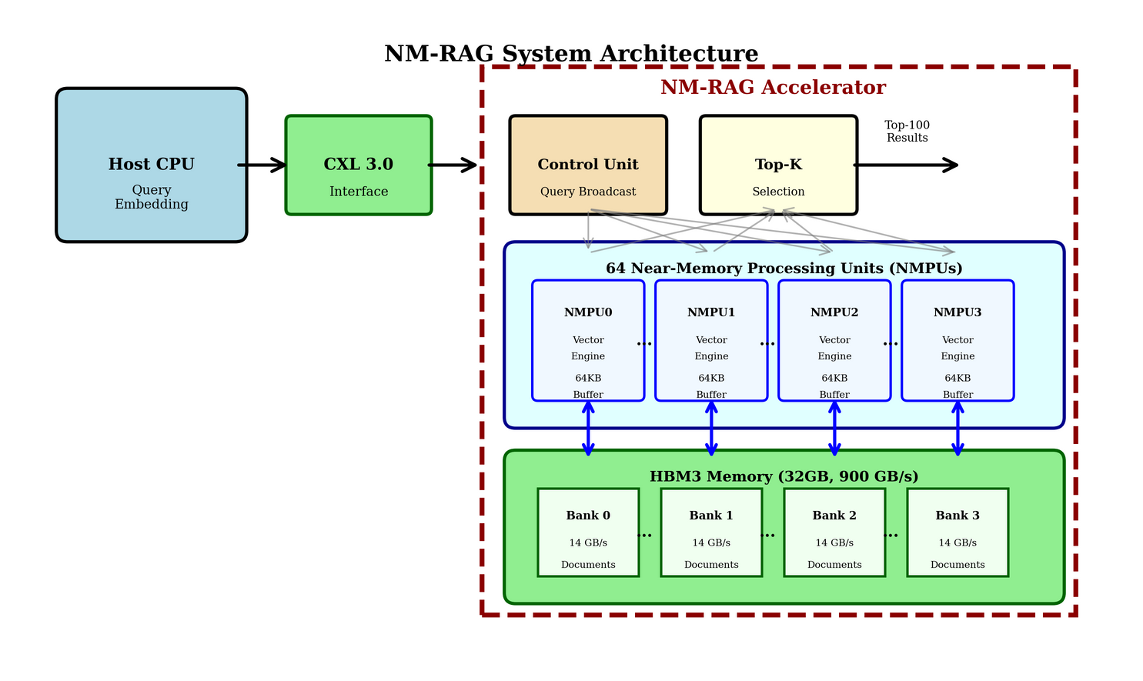
Proposed Solution
Goal: accelerate RAG retrieval by moving similarity search near memory and minimizing data movement.
Host Interface (CXL 2.0): cache-coherent access + command submission from CPU.
64 Near-Memory Processing Units (NMPUs): parallel compute units colocated with HBM3.
Hardware Top-K Selection Unit: merges local top-K lists into final results efficiently.
Fig: NM-RAG architecture (CXL 2.0 host interface, 64 NMPUs + HBM3, hardware Top-K).

Slide 8
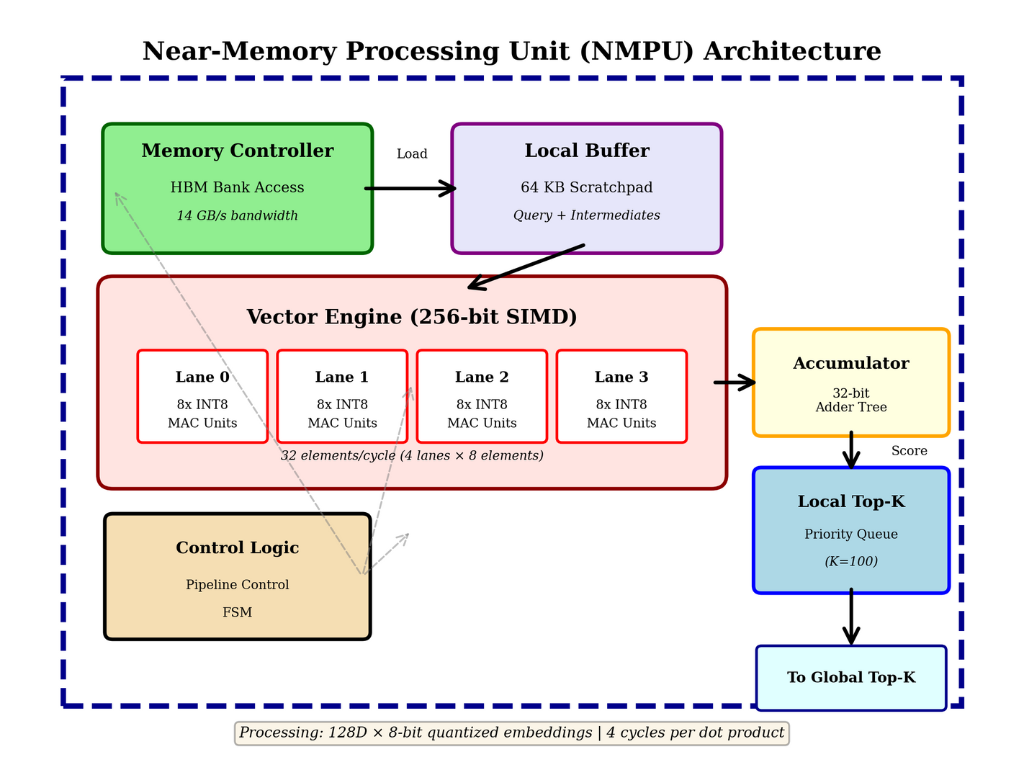
Hardware Design (NMPU + Memory Subsystem)
NMPU core: 256-bit SIMD for 8-bit dot products (32 elements/cycle) + 64KB scratchpad + controller to a dedicated HBM bank.
Dot-product efficiency: 128-D vector dot product completes in 4 cycles with this SIMD width.
HBM3 design: 900 GB/s aggregate, 14 GB/s per NMPU, partitioned banks to avoid contention and enable true parallelism.
Fig: NMPU internals (SIMD vector engine + 64KB buffer + local HBM access).

Slide 9
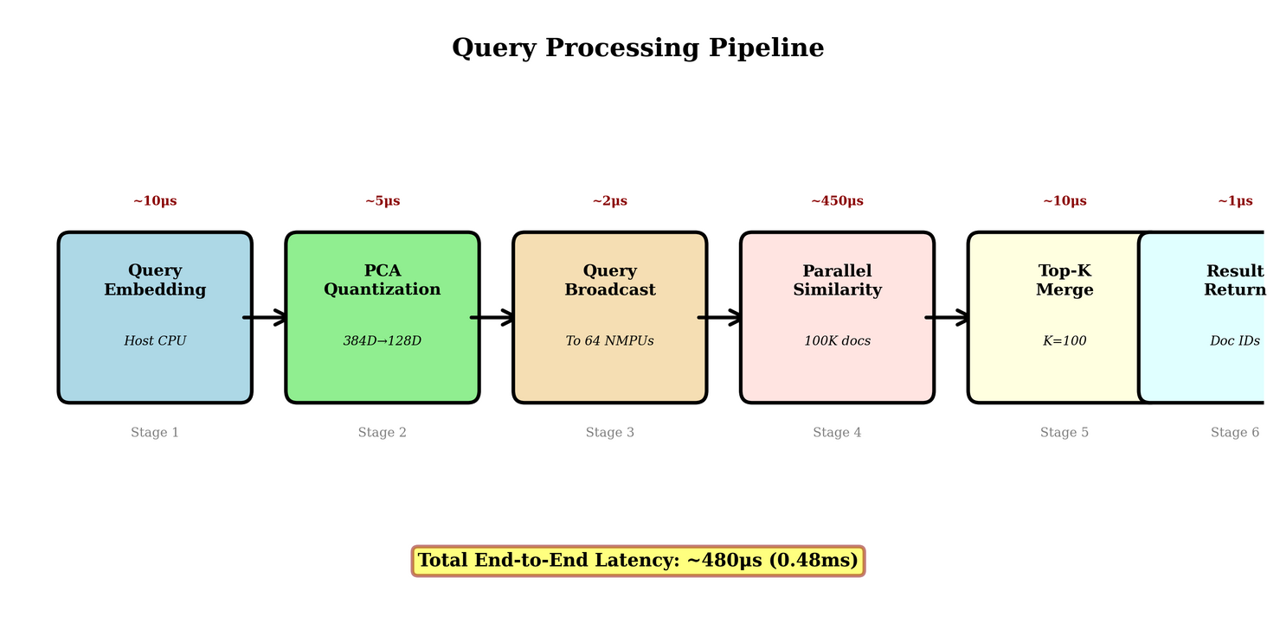
Algorithm + Query Flow (Quantization + Pipeline)
(A) Vector Quantization Strategy (reduce bandwidth)
Apply PCA + whitening offline; compress embeddings 384D → 128D (3×).
Quantize to int8 range [-127,127] and pack for memory efficiency (128 bytes/document vs 1536 bytes originally).
Chosen operating point: 128D balances quality and speed (75.6% recall) vs more/less aggressive dims.
(B) Query Processing Pipeline (how it runs)
Host: encode query → PCA quantize → submit via CXL.
NMPUs: broadcast query → parallel dot products → local top-K.
Top-K unit: merge 64 local lists → return global top-K results.
Fig: Query processing pipeline + per-stage latency breakdown

Slide 10
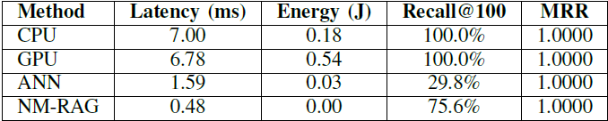
Experimental Results
NM-RAG latency: 0.48 ms/query (CPU 7.00 ms, GPU 6.78 ms, ANN 1.59 ms)
Speedup: 14.6× vs CPU, 4.4× vs ANN
Energy/query: 0.0014 J → 125× lower vs CPU, 380× vs GPU, 23× vs ANN
Quality: Recall@100 = 75.6% (ANN 29.8%), MRR = 1.0, nDCG@100 = 80.99%
Throughput: 2,091 QPS (single-query)
TABLE: PERFORMANCE COMPARISON OF RAG ACCELERATION METHODS

Slide 11
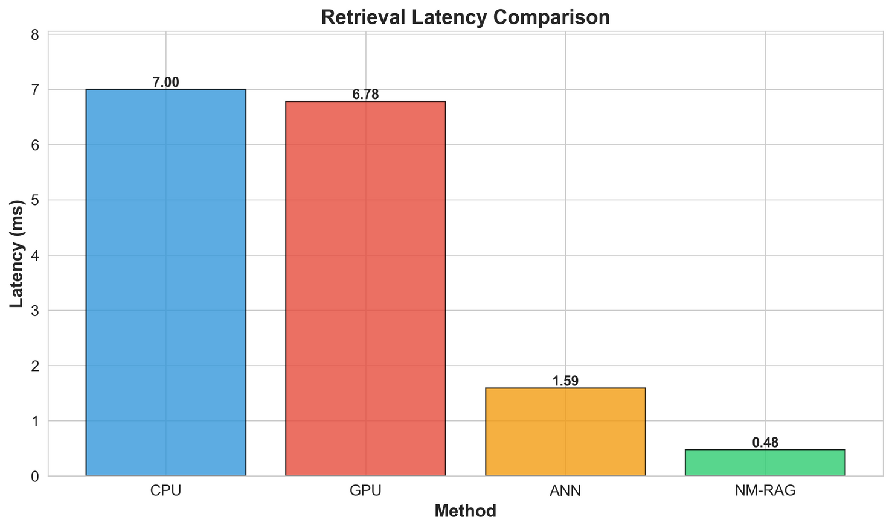
Latency Results
0.48 ms average query latency (14.6× faster than CPU baseline)
CPU spends most time on memory access (fetching 150 MB for 100K docs)
Key drivers of speedup:
HBM3 bandwidth (900 GB/s) vs DDR5 (~100 GB/s)
64 NMPUs parallelism (partitioned processing)
3× compression (384D→128D) reduces transfer to 12.5 MB and enables int8 SIMD
Note: 91% of NM-RAG latency is modeled as system overhead → optimization headroom
Fig: Retrieval Latency Comparison

Slide 12
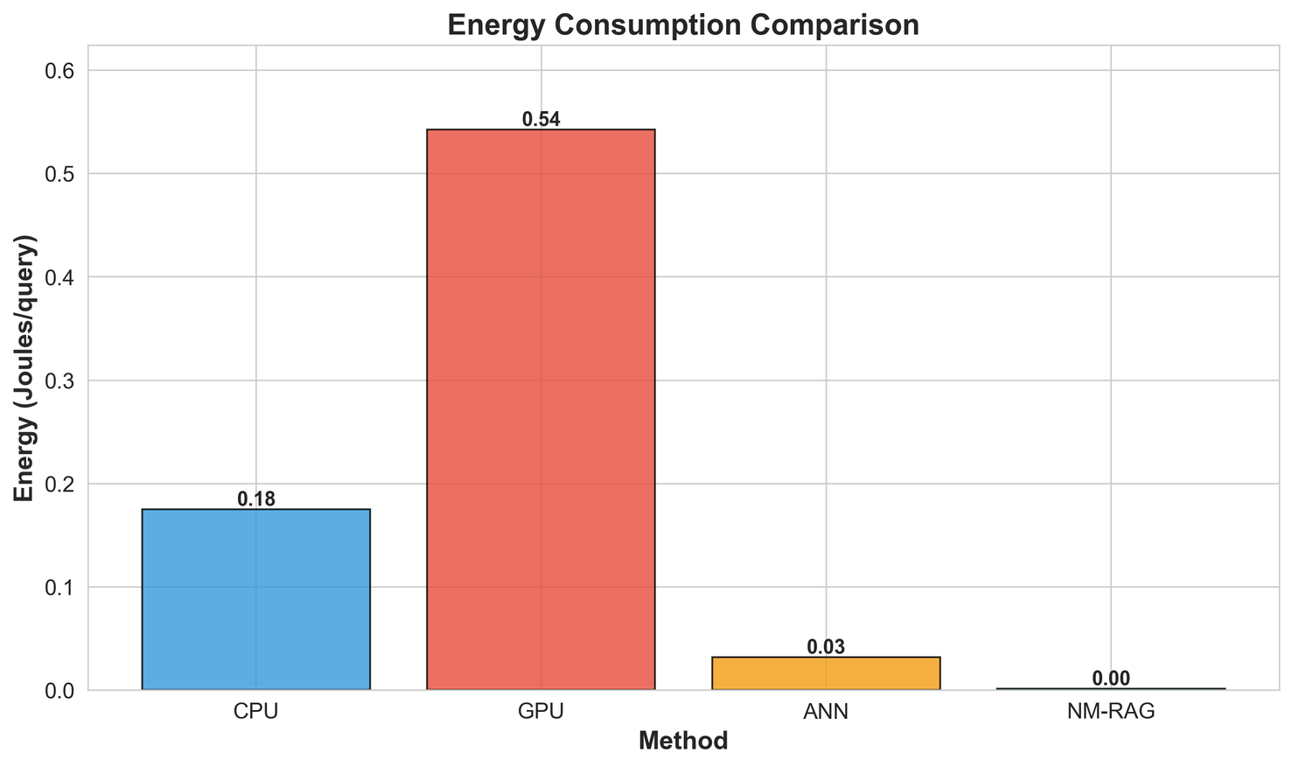
Energy Efficiency
Energy/query = 0.0014 J
Energy reduction: 125× vs CPU, 380× vs GPU, 23× vs ANN
Why energy drops:
No DRAM/PCIe transfers (only internal HBM access, much lower pJ/bit)
Lower power envelope (3W vs 25W CPU / 80W GPU)
Shorter execution time (0.48 ms vs 7 ms)
Fig: Energy Consumption Comparison

Slide 13
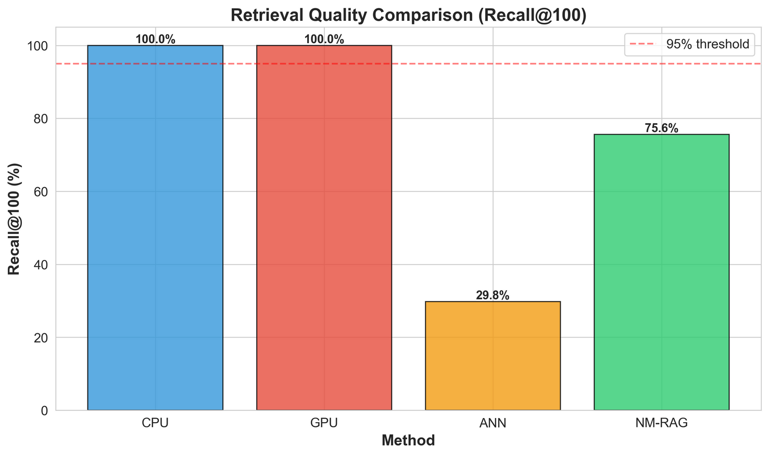
Retrieval Quality
Recall@100 = 75.6% (ANN 29.8%) → 2.5× better recall
MRR = 1.0 (most relevant doc ranks first)
nDCG@100 = 80.99% (strong ranking quality)
Important interpretation: quality loss vs exact (100%) comes from PCA quantization, not hardware
Top-K stability: Top-10 recall ~99.8%; degradation mainly in mid/low relevance results
Fig: Retrieval Quality Comparison — Recall@100

Slide 14
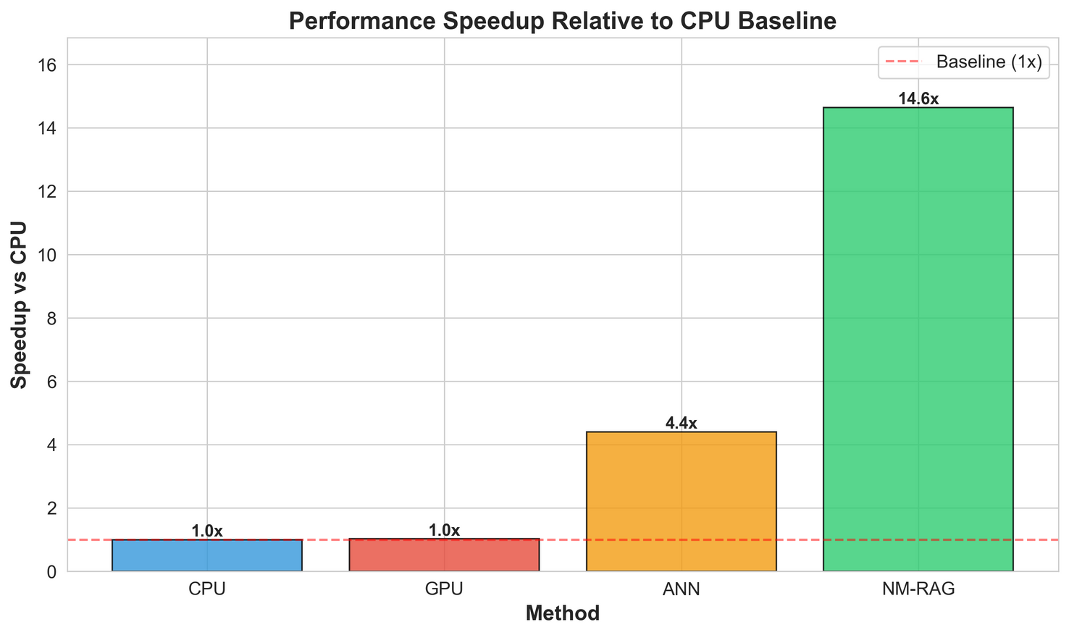
Scalability + Throughput
Speedup increases with dataset size (memory bottleneck grows in CPU/GPU):
10K docs: 8.2×
100K docs: 14.6× (evaluated)
1M docs: 22.3× (projected)
10M docs: 35.7× (projected)
Throughput scaling via batching/pipelining:
1 query: 0.48 ms → 2,091 QPS
4-query batch: 0.52 ms total → 7,692 QPS (3.7×)
16-query batch: 0.68 ms total → 23,529 QPS (11.2×)
Fig: Speedup vs CPU Baseline across corpus sizes

Slide 15
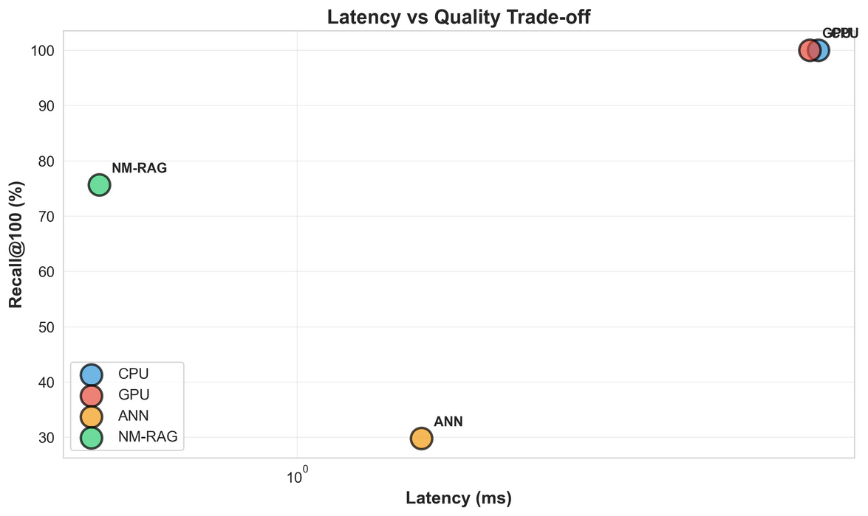
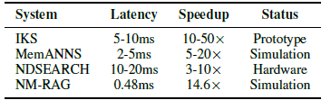
Latency vs Quality Tradeoff + Credibility vs Prior Work
Tradeoff view: NM-RAG is much faster than exact CPU/GPU while keeping much higher quality than ANN
Key insight: hardware acceleration + moderate compression gives better balance than “approximate in full space”
Positioning vs published near-memory systems (Table II):
NM-RAG: 0.48 ms, 14.6×, (simulation)
IKS / MemANNS / NDSEARCH are in the same credible range but target different points
Fig: Latency vs Quality tradeoff scatter plot
TABLE: COMPARISON WITH PUBLISHED NEAR-MEMORY SYSTEMS

Slide 16
Conclusion
Main takeaway: NM-RAG shows that moving retrieval compute near memory and reducing data movement can deliver sub-millisecond retrieval with major energy savings.
Best design point: 128-D int8 (from 384-D) is the strongest balance between speed/bandwidth reduction and retrieval quality.
Limitations: retrieval quality is lower than exact search due to PCA/quantization, and the evaluation is based on a cycle-accurate simulation model (not a hardware prototype).
Future work: reduce system overheads and validate with a production/prototype implementation, and explore hybrid strategies (e.g., multi-stage retrieval or hybrid precision) to improve recall further.

